Slide 1
IT System Architecture
Data and ML Pipeline

Slide 2


People
People
Systems
Systems

Slide 3
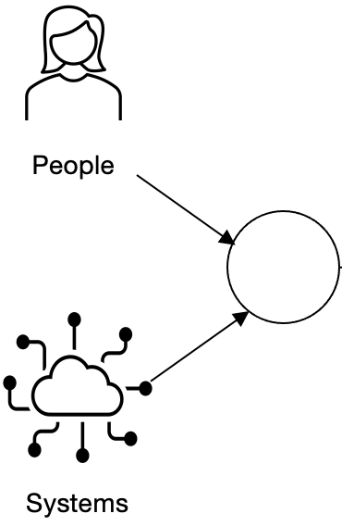
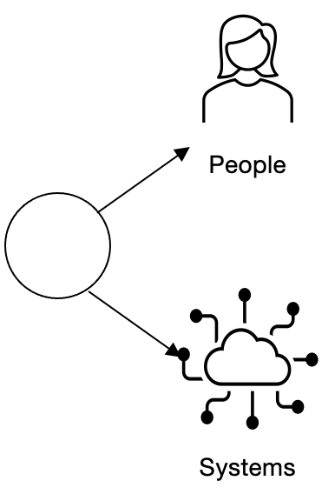

Slide 4

Extract
Transform
Load

Slide 5
Data Pipeline
Extract
Transform
Load
Data Producers
Data Transformation (ETL/ELT)
Data Consumers

Slide 6
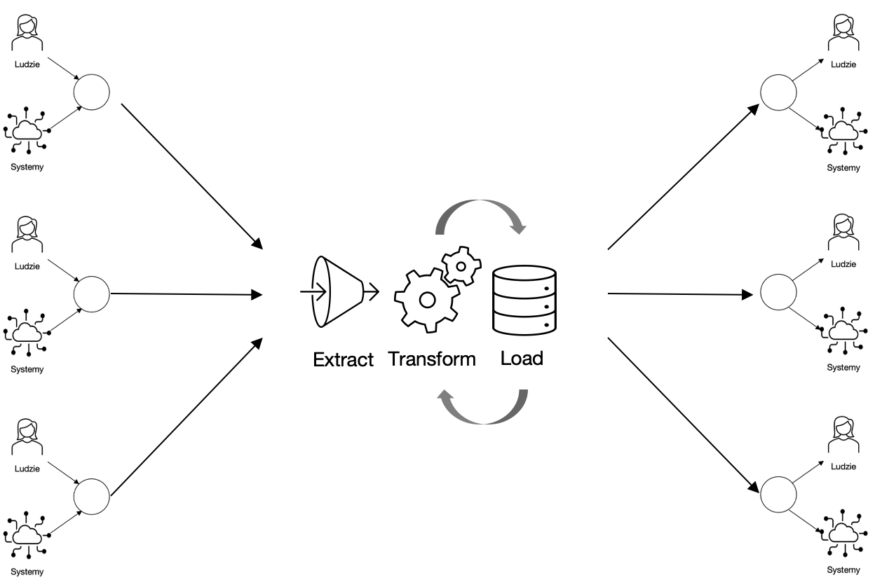

Slide 7
Extract
ML
Load

Slide 8
Extract
ML
Load
Preparation
Training
Evaluation

Slide 9

Extract
Load

Slide 10

Data producers
Transation systems
IoT sensors
Domain systems
Databases
Data Warehouses
Data lakes
Social media
Logs
Emails
Other documents

Slide 11
Data transformation
Extract
Transform
Load

Slide 12
Data consumers
Storage locations:
Database
Data warehouse
Data lake
Applications:
Desktop BI
AI Applications
Analytics Applications
...

